Slide 1
Tender text in specification business
Kim van Rosmalen
PLS Europe
October 2016

Slide 2
The need
The specification business is declining over years and there is a need from different CSU’s to make tender text available on European level for the specification business as a supporting tool to make it easier to describe our specification products

Slide 3
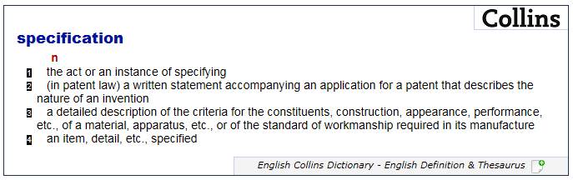
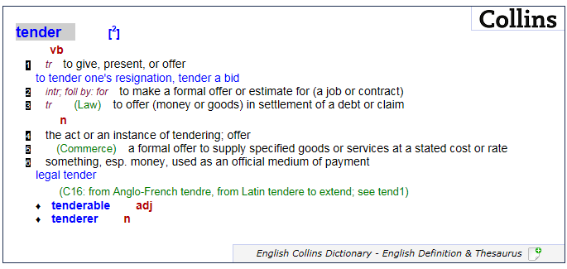
The definition
Tender / specification

Slide 4
The challenge
How can we find an European approach, where local demands differ per CSU, and make tender text available for our specification products

Slide 5
The approach
Step 1 – analyze of current offering of tender text in PLS Europe
Step 2 – analyze current way of working in CSU’s
Step 3 – competitor analysis
Step 4 – check with Peter v Diesen
Step 5 – needs from CSU’s
Step 6 – check possibilities with Digital team
Step 7 – determine what/how/when/ if we make available tender text available

Slide 6
Step 1 – Current Offering PLS Europe
Only outdoor offers tendertext
Segment | Tender text | Family level | 12-nc level | Available on E-cat |  | Document type
O&I
R&H
Outdoor |  |  |  |  |  | Word file -handmade

Slide 7
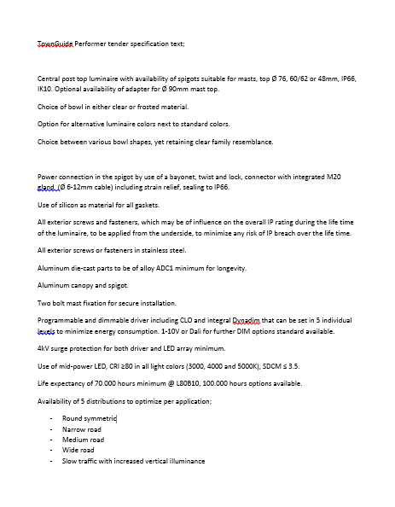
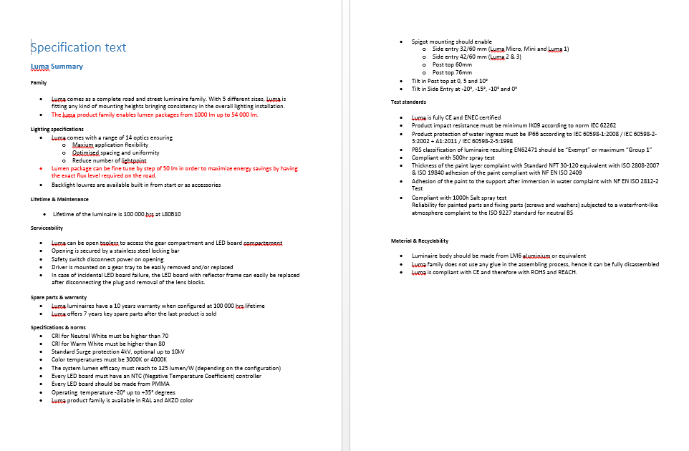
Step 1 – Current Offering PLS Europe
Examples
Townguide-outdoor
Luma-outdoor

Slide 8
Step 2 – Current Way of working CSU’s
CSU | Tender text | Family level | 12-nc level | Available on internet | Automatic generated | Document type
BLX |  |  |  | Difficult to find |  | Word
Dach |  |  |  |  |  | Internet -Notepad
Iberia
Nordics | Outdoor | Outdoor |  |  | In excel | Excel-PDF
France
UKI
CEE
IIG
NO INPUT YET

Slide 9
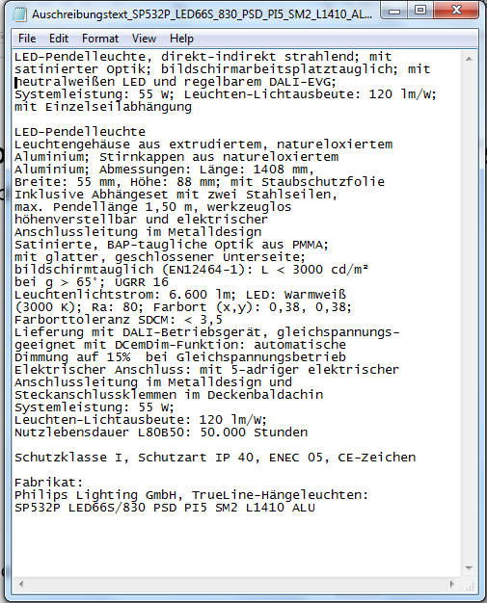
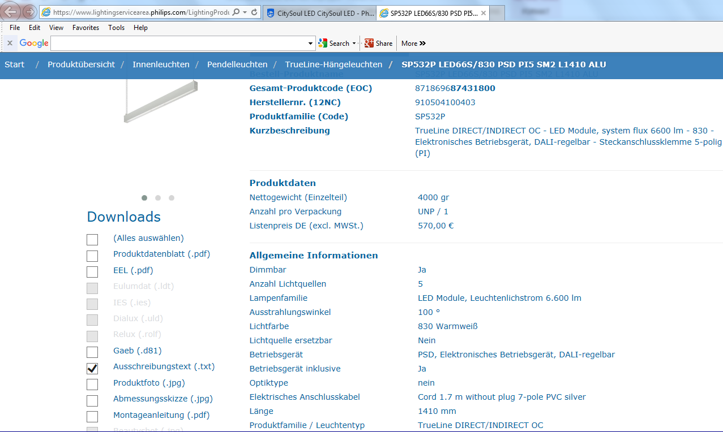
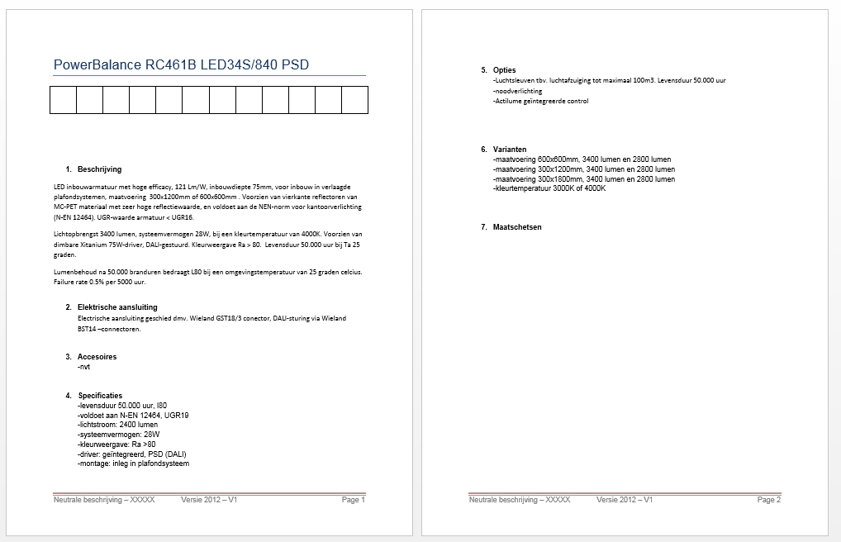
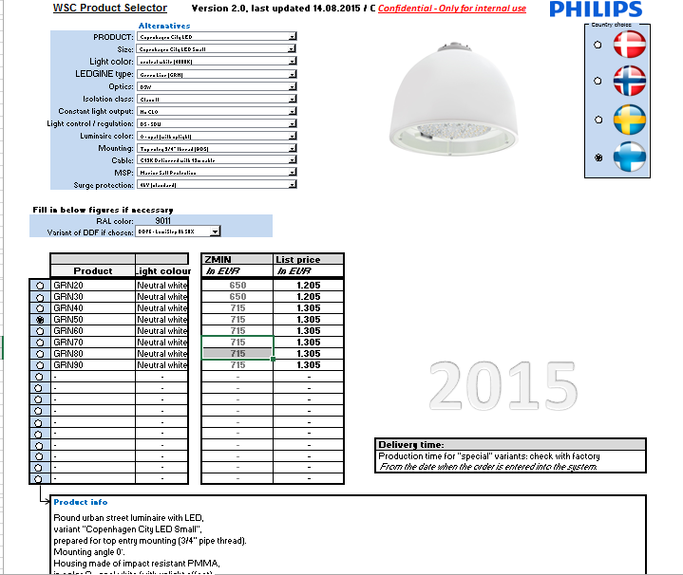
Step 2 – Current Way of working CSU’s
Examples
Click on picture to go to the website
DACH
Netherlands
Nordics

Slide 10
Step 3 – Competitor analysis
Competitor | Tender text | Family level | 12-nc level | Available on internet | Automatic generated | Document type
Zumtobel |  |  |  |  |  | PDF
Trilux |  |  |  |  |  | Notepad
Fagerhult
Disano
Erco |  |  |  |  |  | Notepad
Etap
Opple
Waldman
Thorn |  |  |  |  |  | Notepad
Glamox
Iguzinni

Slide 11
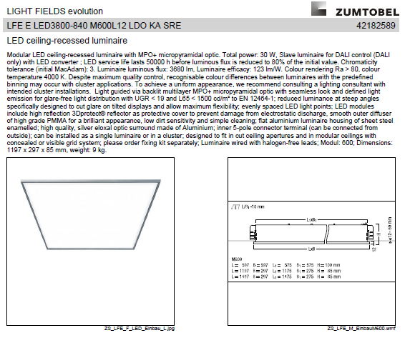
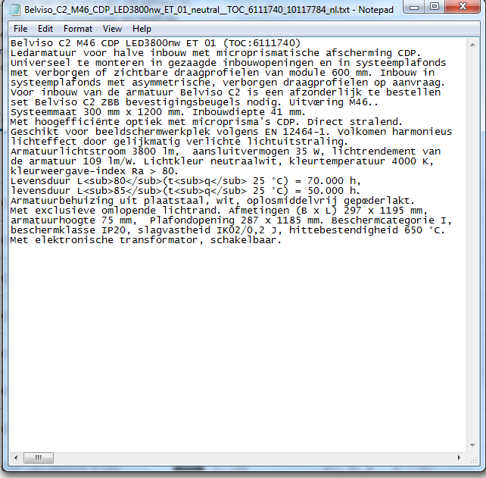
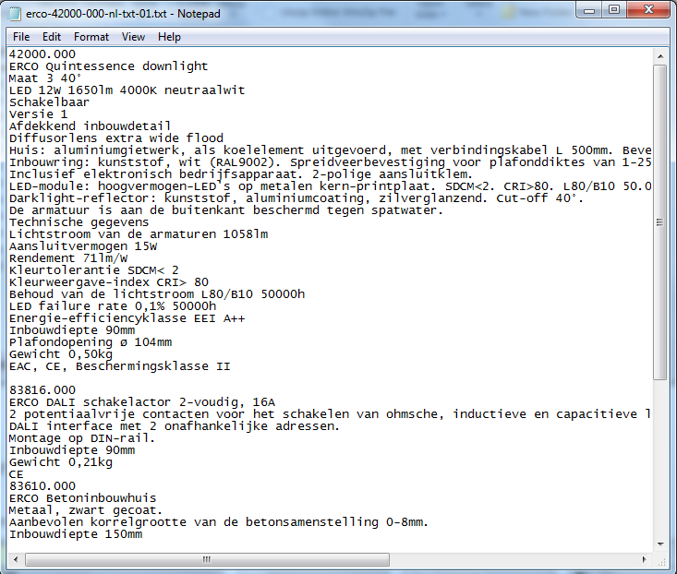
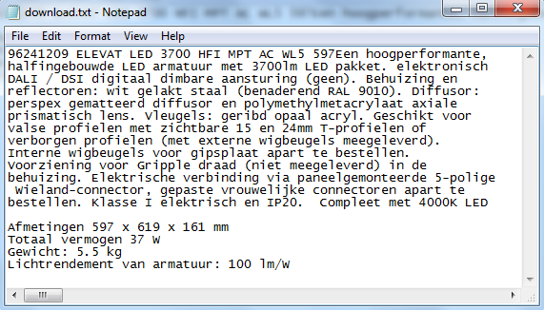
Step 3 – Competitor analysis
Examples
Trilux
Zumtobel
ERCO
Thorn

Slide 12
Step – 4 check with Peter v Diesen
Outcome of investigation 7/8 years ago
Investigation done 7/8 years ago
CSUs could not agree on the look&feel and functionality
Prisma could not facilitate sufficiently (MCM can)
Possibility to make a tender text based on attributes per 12 NC
Create per attribute (long) description
International text not always usefull in a local CSU. Local adaptations should be part of local translations

Slide 13
Step 5 – Needs from CSU
CSU | Tender text | Family level | 12-nc level | Available on internet | Automatic generated | Document type
BLX
Dach |  |  |  |  |  | Internet -Notepad
Iberia |  |  | Standard + configurated
Nordics |  |  | Standard + configurated
France
UKI
CEE
IIG
NO INPUT YET

Slide 14
Step 5 – Needs from CSU
CSU | Tender text
BLX
Dach
Iberia | 1. editable text to be used to fill the table in the tender, it would be nice in excel or in word. Engineers normally use .bc3 files. 2. All technical data in e-cat, together in a comprehensive text. 3. Adding some “nice words” about the products with the principal advantages and benefits. 4. Competitive difference (for example OC when we were first in the market, the most efficient luminaire in the market, etc.) 5. Needed data (minimum). All this data must be join together in a comprehensive text, with articles, prepositions, etc: Material Dimension Installation (surface, suspended, recessed, type of ceiling) Flux Color temperature Power consumption Driver IP CRI Cover (prismatic, opal, etc.) Color UGR
Nordics | The Dach tool
France
UKI
CEE
IIG
NO INPUT YET

Slide 15
Step – 6 check possibilities with Digital team
Meeting on 20th of October with:
Johan Spin- datamanagement
Gaby Markovic- digitl touchpoints in MCM team
Ralph Hulscher- solution architect
Steven Kardinaal

Slide 16
Step 7 – determine what/how/when/ if we make available tender text available
Possible options:
Do nothing
Make a PDF document available on E-cat on family level
Make an excel-file like Nordics available internal on family level
Copy the Dach solution
Create from MCM a tool per 12nc, including configurator products on Notepad
Option 5 is most preferred

Slide 17
Next steps
Start small- PowerBalance standard codes only
Supply info on P for pilot (Kim)
Family text
Which attributes (check attribute name keep/change)
Translate to an output/ w-o-w / roles per department document including effort picture (Ralph/Karin)
Challenges: configurator products
Output in notepad
Timeline uncertain, all focus on performance of MCM
Don’t make it mandatory in MCM
Determine which families should have this (trade vs spec vs ledinaire)

Slide 18
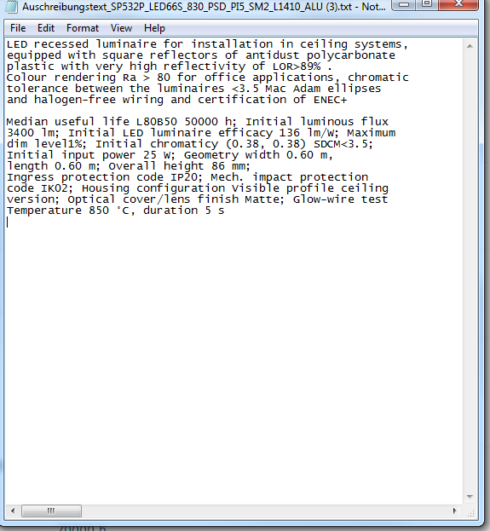
New text field to be entered per commercial family by EPM and translated locally
Please review tendertext
Example PowerBalance
LED recessed luminaire for installation in ceiling systems, equipped with square reflectors of antidust polycarbonate plastic with very high reflectivity. Colour rendering Ra > 80 for office applications, chromatic tolerance between the luminaires <3.5 Mac Adam ellipses and halogen-free wiring and certification of ENEC+
Median useful life L80B50 50000 h; Initial luminous flux 3400 lm; Initial LED luminaire efficacy 136 lm/W; Maximum dim level1%; Initial chromaticy (0.38, 0.38) SDCM<3.5; Initial input power 25 W; Geometry width 0.60 m, length 0.60 m; Overall height 86 mm; Ingress protection code IP20; Mech. impact protection code IK02; Housing configuration Visible profile ceiling version; Optical cover/lens finish Matte; Glow-wire test Temperature 850 °C, duration 5 s
Derived from MCM per (standard) 12NC
Type of characteristics & order chosen per family by EPM
Output will be in wordpad

